Slide 1
Sidmouth Beach Management Scheme
Steering Group Meeting
Royal HaskoningDHV
09 August 2018
Project related

Slide 2
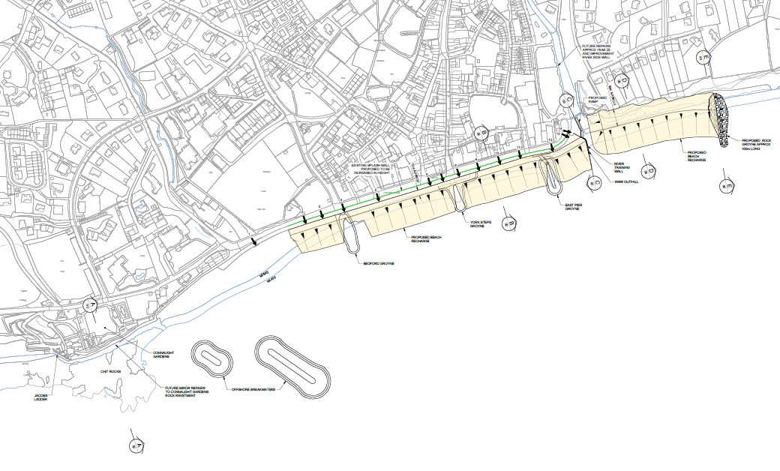
Preferred Option Plan View

Slide 3
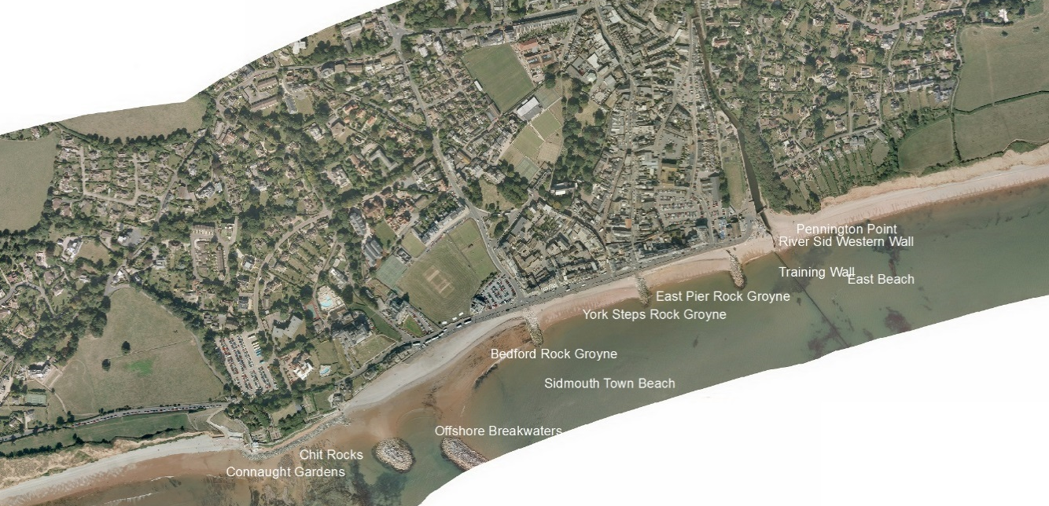
Coastal Processes Overview – what is happening now
Primary reason for net drift is due to previous shingle nourishment. Surplus shingle naturally bypasses onto East Beach. If beach is not nourished there would be negligible shingle supply downdrift.
Outflanking of shingle can occur. Shingle will transiently sit on East Beach before continuing to move eastwards.
Shingle moves west during a SE event and builds up between the promenade and nearshore breakwaters. Due to the sheltered environment sediment becomes trapped.
Majority of sediment will move to the east under the predominant south west conditions.

Slide 4
Beach Management Plan - Objectives
Manage the risk of coastal flooding and erosion along the Sidmouth frontage.
Scheme must not adversely impact the integrity of the environmental features.
The BMP identifies measures to develop and implement a sustainable solution.
The OBC is the next stage of the BMP and is required to develop the BMP outcomes.
Preferred option within the BMP
One or two new rock groynes along East Beach over a distance of 200m.
Modify length of River Sid training wall and East Pier Rock Groyne (if required).
Repairs to River Sid training wall
Beach recharge and recycling along Sidmouth Town and East Beach frontages.

Slide 5
Principles of Beach Management
The approved beach management approach at Sidmouth East Beach consists of the retention of a design beach by groynes.
The key to successful beach management involves retaining a design beach for as long as possible. At Sidmouth this is balanced against the need to allow the cliff to continue to erode.
The required design beach (size and level) is identified through modelling and the role of the groyne structures is to hold the beach in place.
The closer spaced groynes are, the more control you have over the beach.
The longer groynes are, the more control you have over the beach.
Short and widely spaced groynes have less control over the beach, less certainty over operation, and are likely to have increased beach management costs for the future.
Beaches are mobile and will be expected to move within bays, and reshape, during storm events.
A beach needs to have a minimum crest level and crest width otherwise it will be very susceptible to losses (which could be permanent) under mild storm events.
Overtopping will still occur over the beach crest under sea storms which will continue to cause cliff erosion.
Recycling vs Renourishment (importation) cost: £10 per m³ vs £40 per m³.

Slide 6
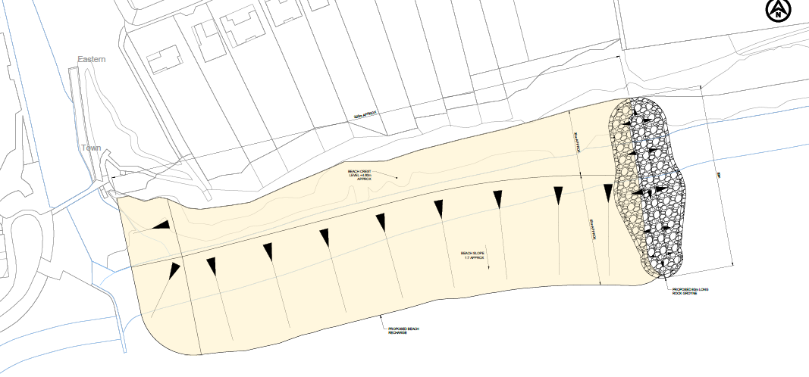
Concept Options
Option 1: 1no. 80m rock groyne

Slide 7
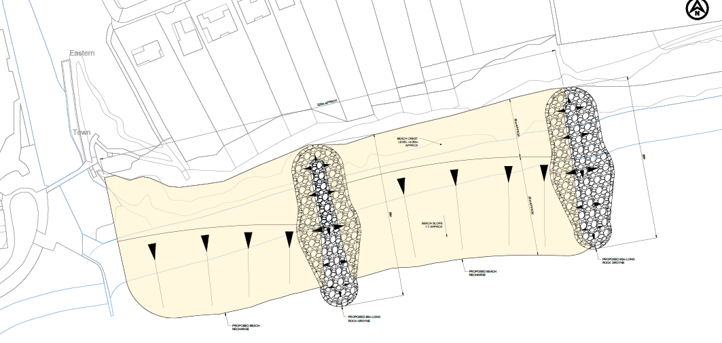
Concept Options
Option 2: 2no. 80m rock groyne

Slide 8
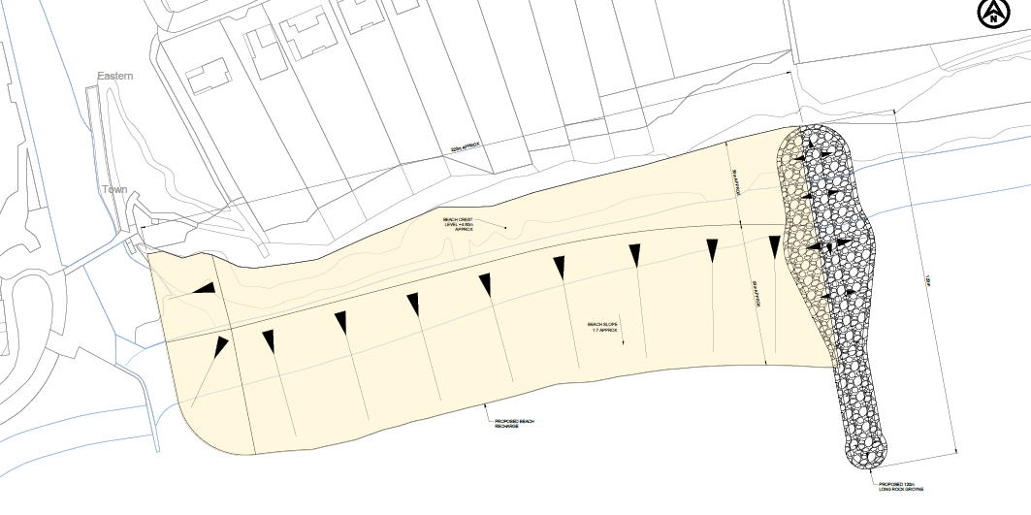
Concept Options
Option 3: 1no. 120m rock groyne

Slide 9
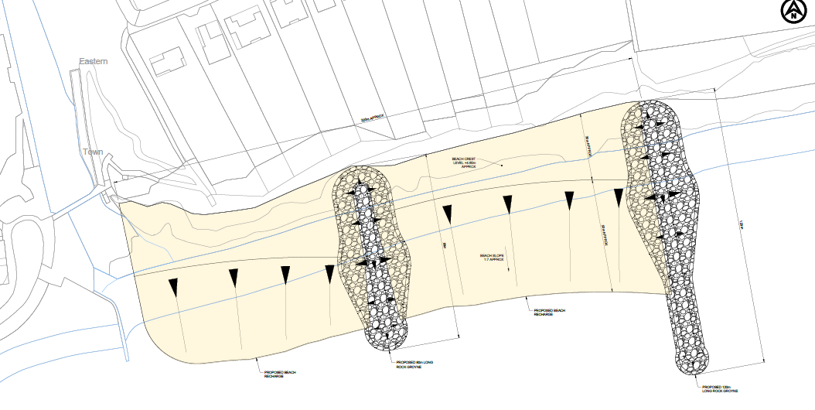
Concept Options
Option 4: 1no. 80m rock groyne and 1no. 120m rock groyne

Slide 10
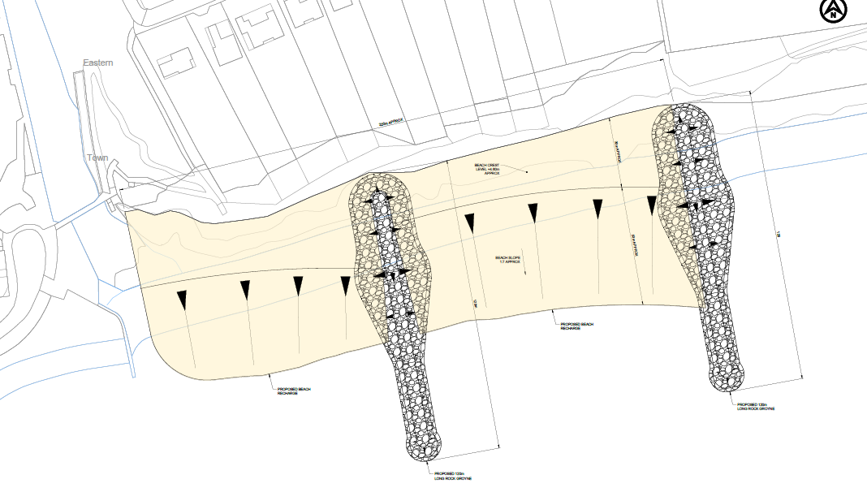
Concept Options
Option 5: 2no. 120m rock groyne

Slide 11
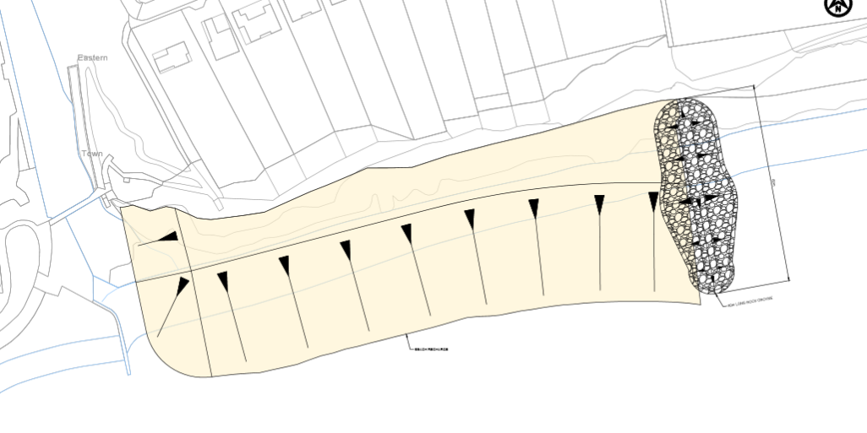
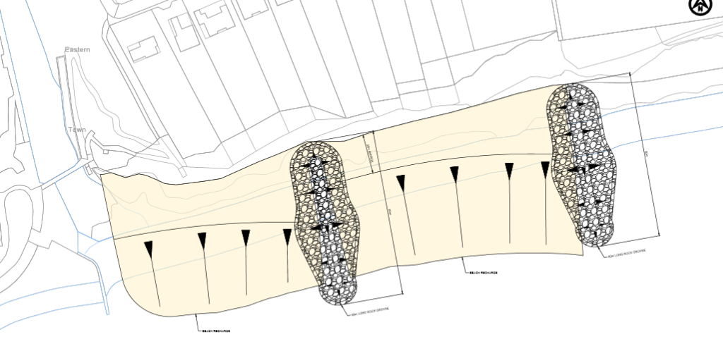
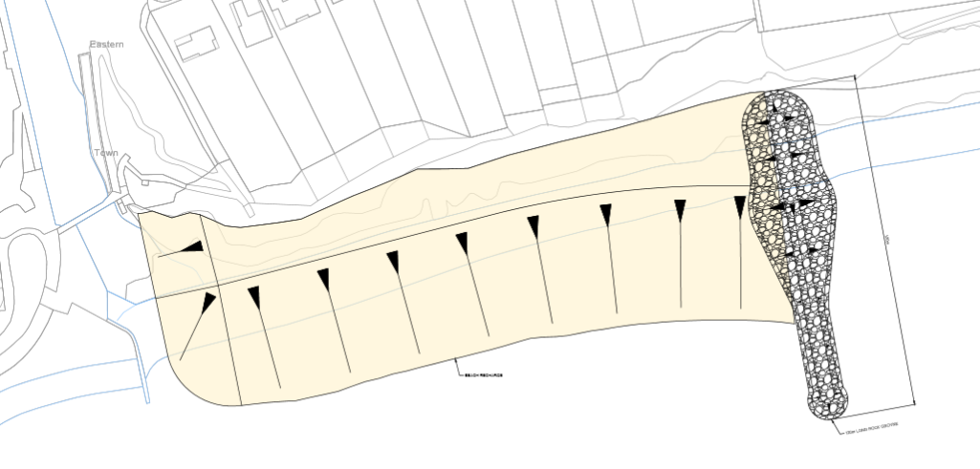
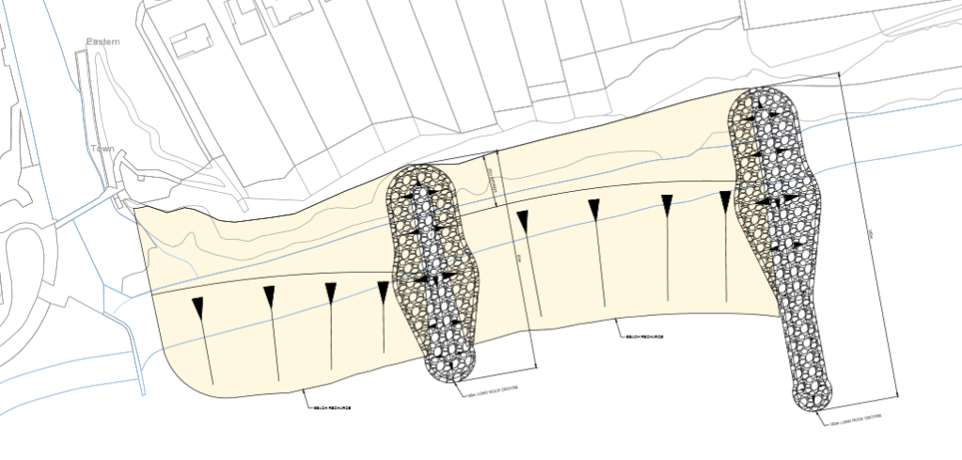
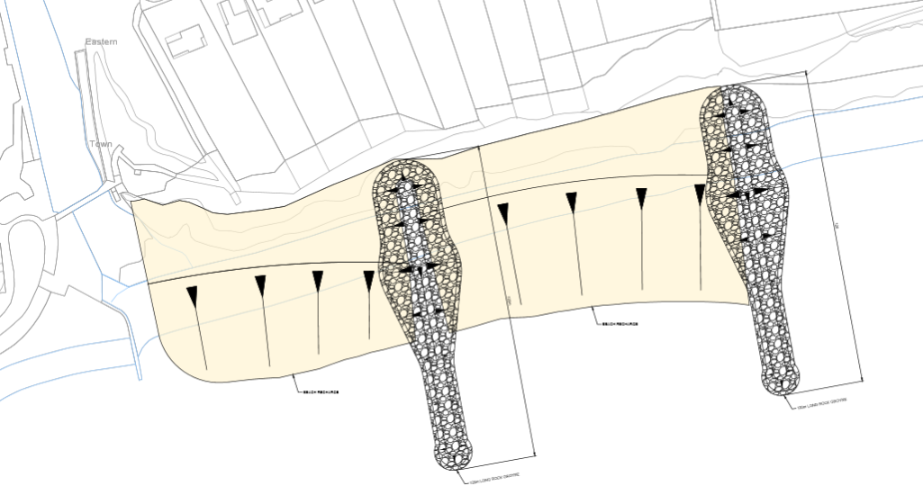
Appraisal Summary – Main Criteria
Criteria / Option |  | 1no. Short groyne | 2no. Short groyne | 1no. Long groyne | 1no. Short and 1no. Long groyne | 2no. Long groynes
Maintenance (frequency and cost of recycling and recharge) |  | Very High | High | Medium | Low | Very Low
Environmental Impacts |  | Low | Medium | Medium | High | High
Cost | PV Initial Construction Cost | £7.5M | £7.9M | £9.0M | £9.5M | £10.3M
 | FDGIA Contribution | £3.1M | £3.6M | £5.1M | £5.3M | £5.5M
 | EDDC Contribution | £4.4M | £4.3M | £3.9M | £4.1M | £4.8M
 | PV Future Maintenance Cost | £11.7M | £9.7M | £5.0M | £4.7M | £4.6M
 | PV Total Cost | High | High | Low | Low | Medium
 | PF Score | 44% | 49% | 62% | 62% | 58%
Benefit Cost Ratio |  | PV Benefit: £137.9M PV Cost: £19.2M Benefit Cost Ratio: 7.15 | PV Benefit: £137.9M PV Cost: £17.6M Benefit Cost Ratio: 7.81 | PV Benefit: £137.9M PV Cost: £14.1M Benefit Cost Ratio: 9.75 | PV Benefit: £137.9M PV Cost: £14.2M Benefit Cost Ratio: 9.66 | PV Benefit: £137.9M PV Cost: £15.0M Benefit Cost Ratio: 9.18

Slide 12
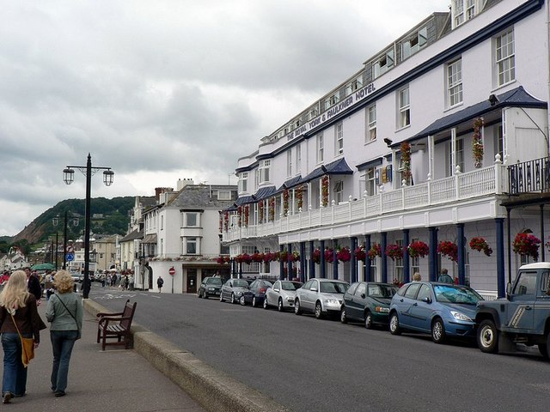
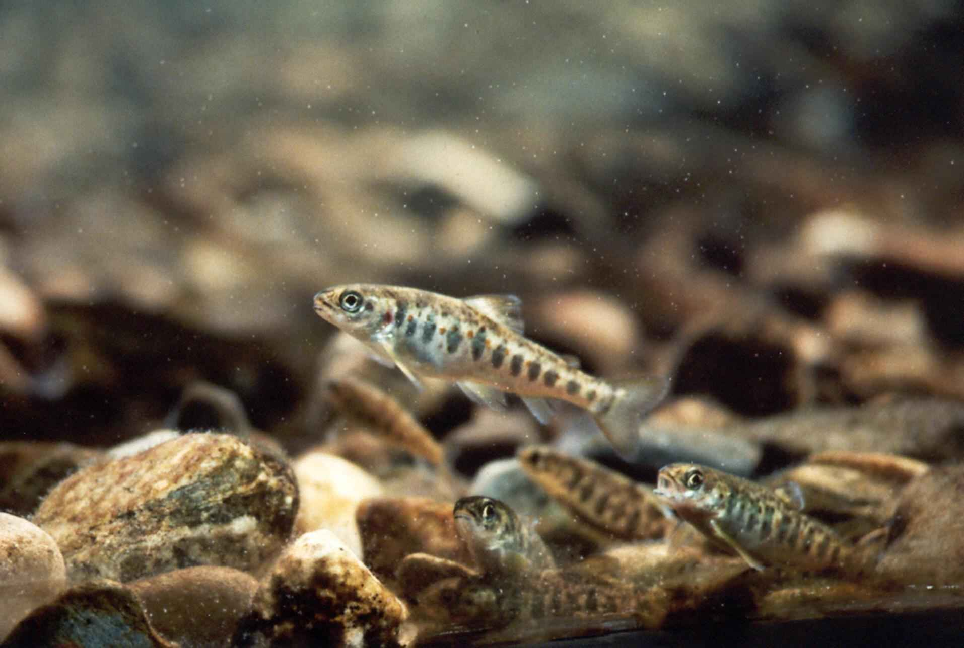
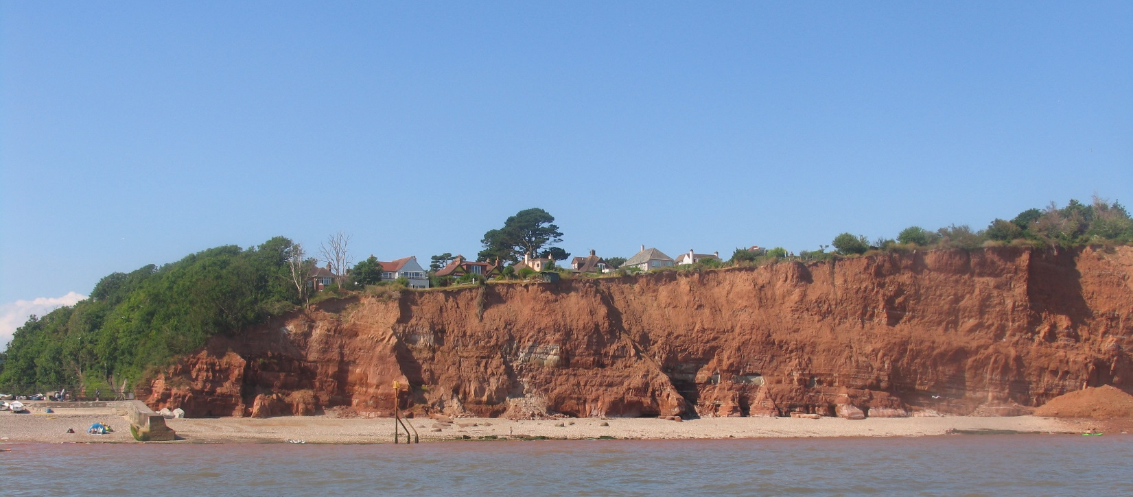
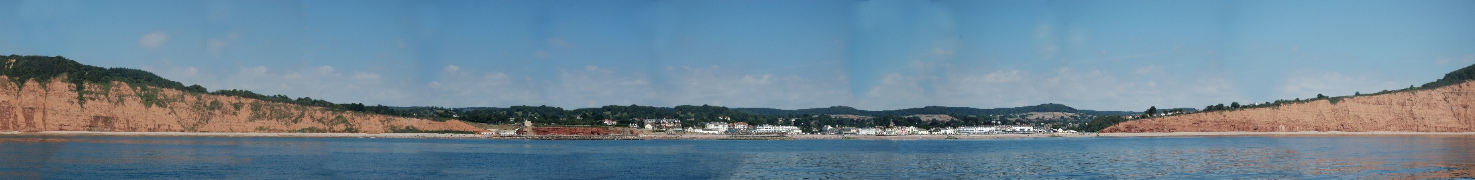
Environmental Considerations
Environmental Objective from BMP:
Does not compromise or adversely impact the integrity of the environmental features of the Dorset and East Devon UNESCO World Heritage Site, Sidmouth to West Bay Special Area of Conservation or the Sidmouth to Beer Coast Site of Special Scientific Interest
Technical assessments linked to other consents e.g. Water Framework Directive compliance, Habitats Regulations Assessment etc

Slide 13
Preferred Option – Outline Design
Rationalisation of beach profiles and rock groyne design
Visualisations of splash wall and east beach
These will be refined further in the subsequent detailed design

Slide 14
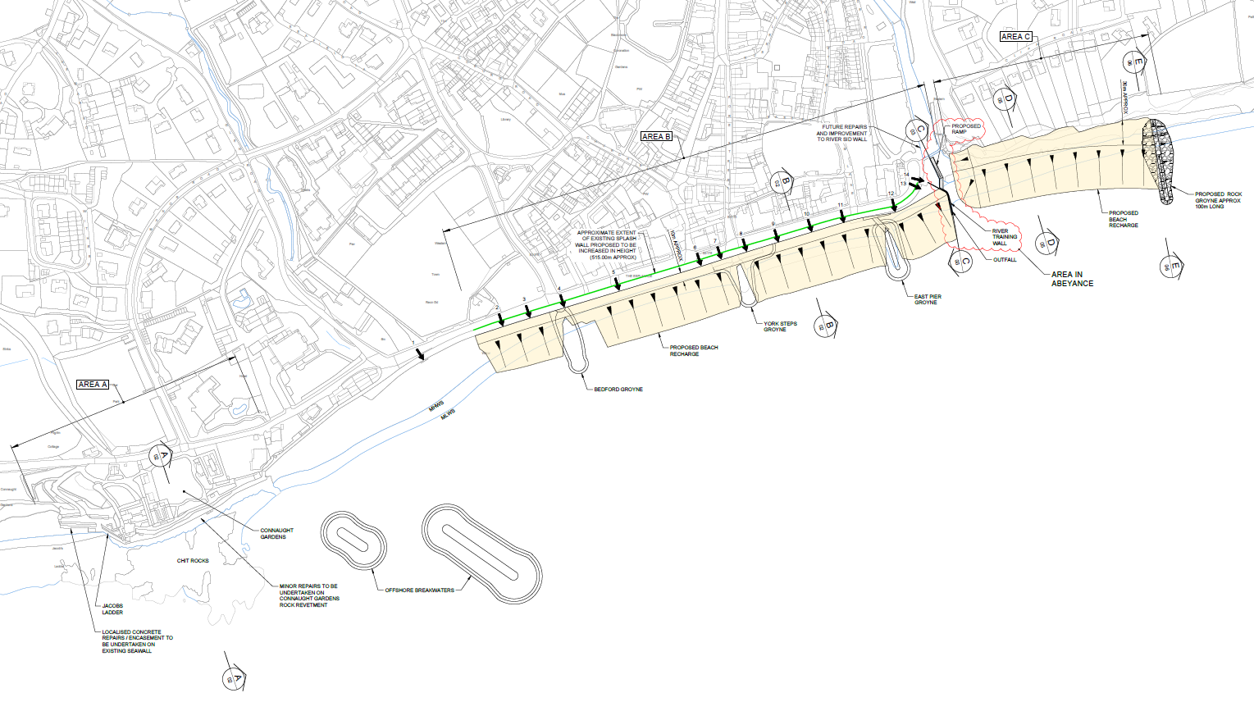
Preferred Option – General Arrangement

Slide 15
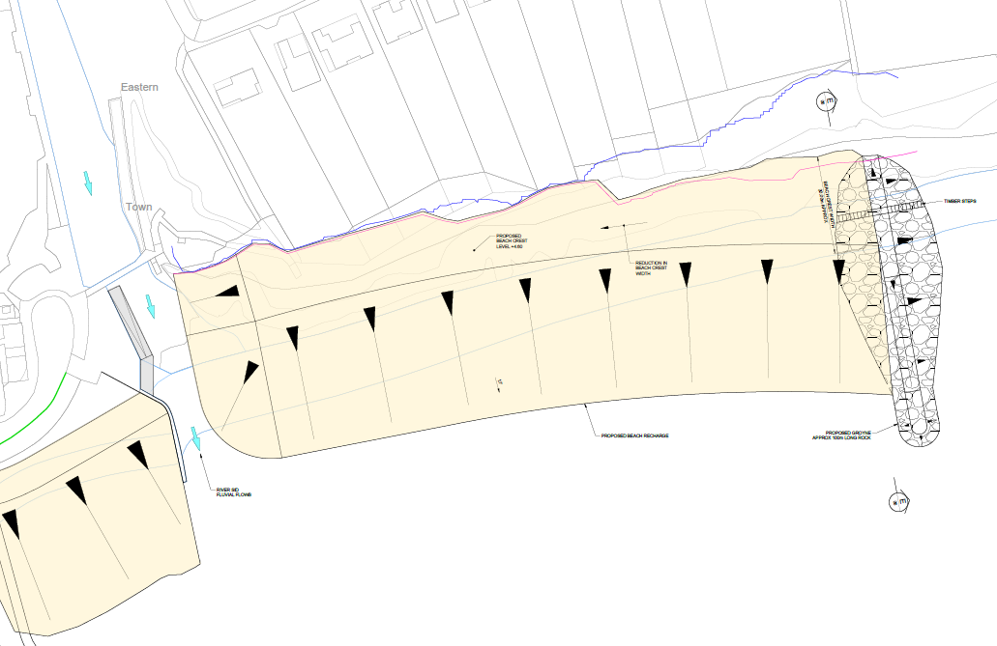
Preferred Option – East Beach – Plan

Slide 16
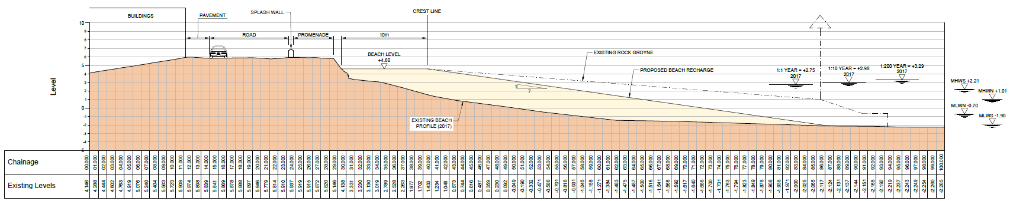
Preferred Option – Sidmouth Town Beach – Long Section

Slide 17
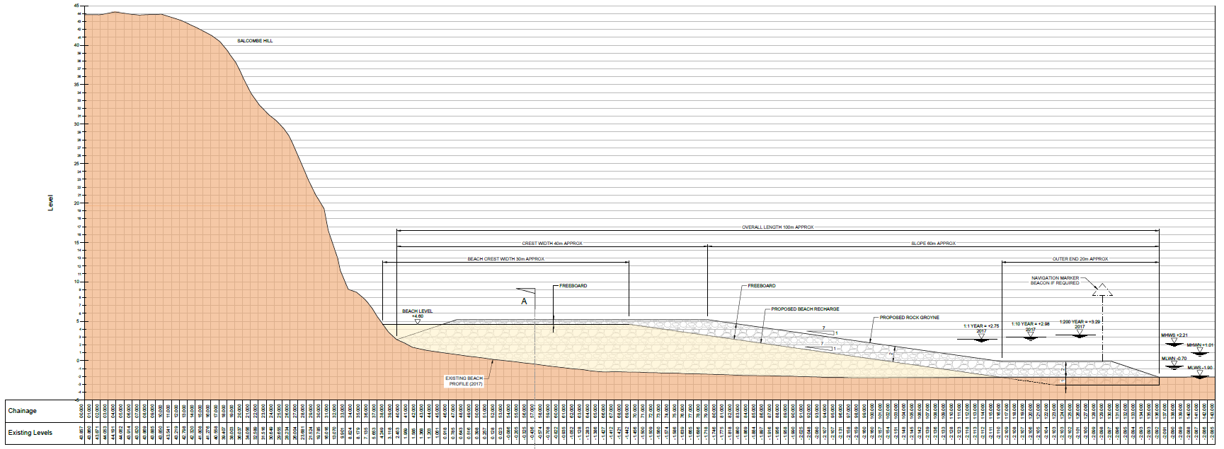
Preferred Option – East Beach – Long Section

Slide 18
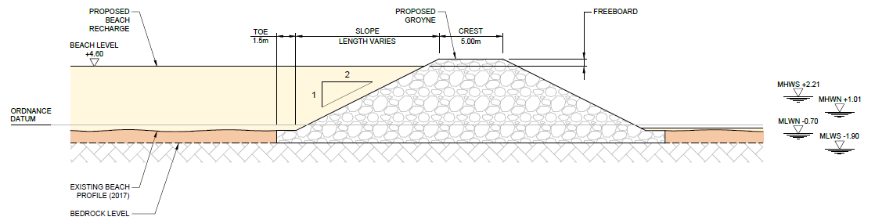
Preferred Option – East Beach – Cross Section

Slide 19
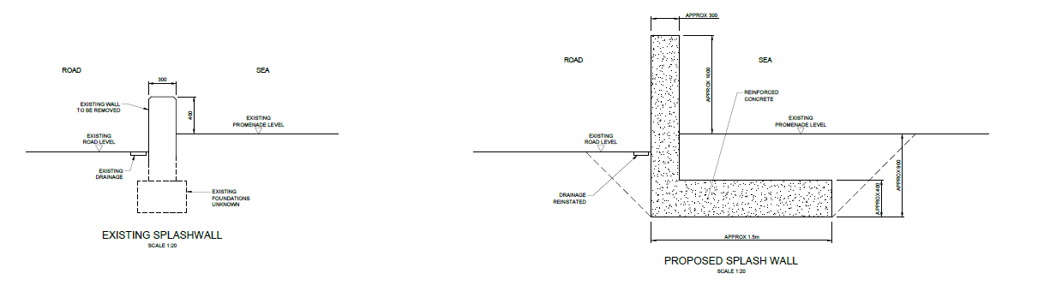
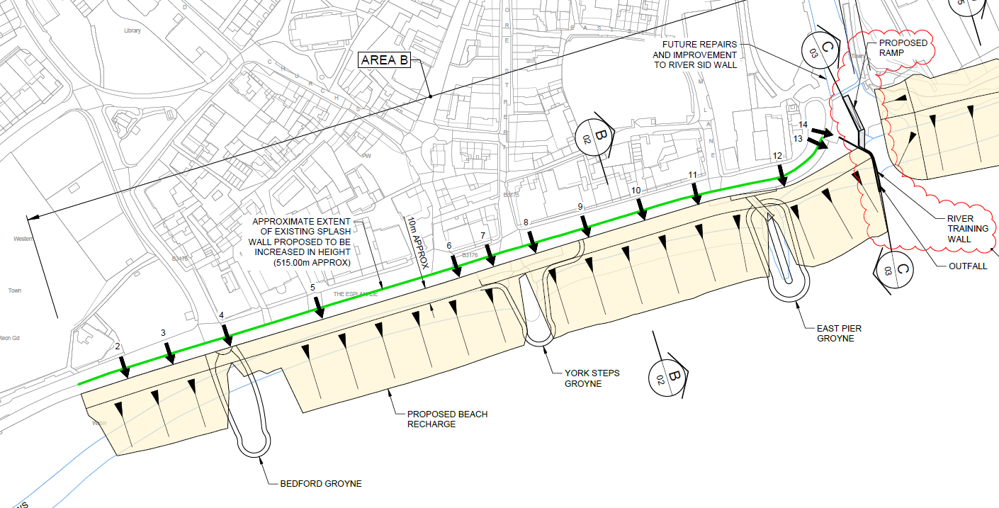
Preferred Option – Sidmouth Town Splash Wall

Slide 20
Financial summary
Present Value Design and Construction Costs: £8.9M
Present Value Post Construction Costs (maintenance): £4.7M
Present Value Total Scheme Cost: £13.6M
EA Partnership Funding Score: 59%
Flood Defence Grant in Aid: £5.2M
EDDC Contributions Required: £3.7M

Slide 21
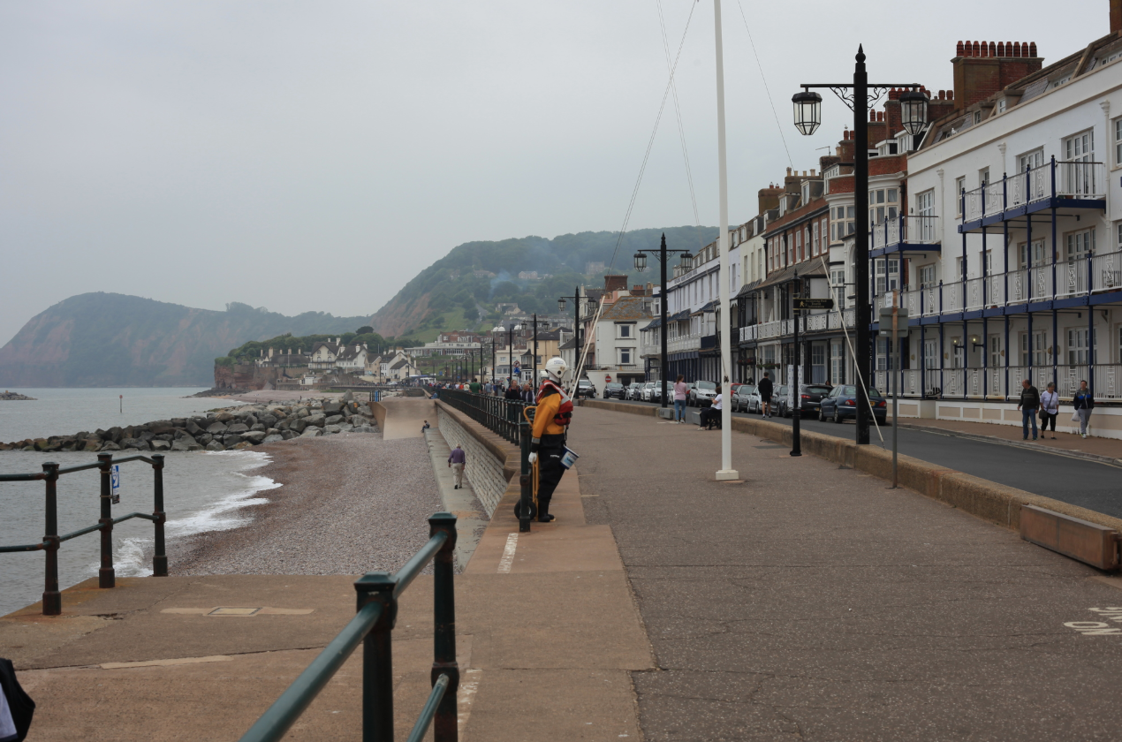
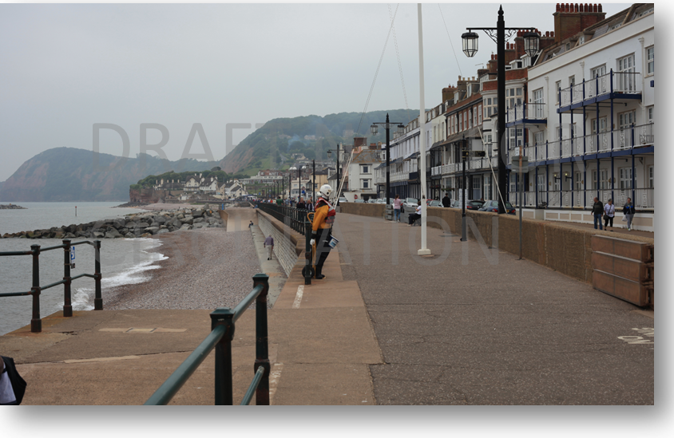
Preferred Option – Sidmouth Town
After
Before

Slide 22
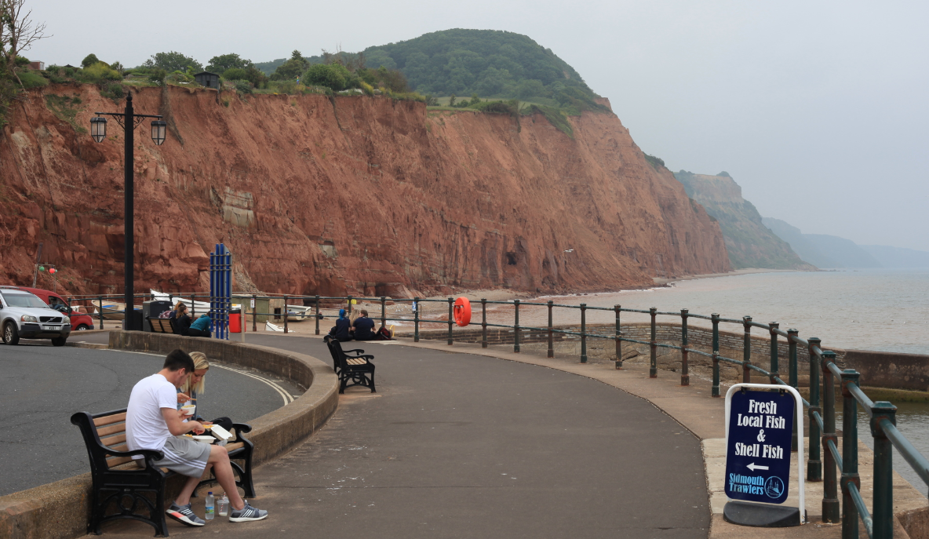
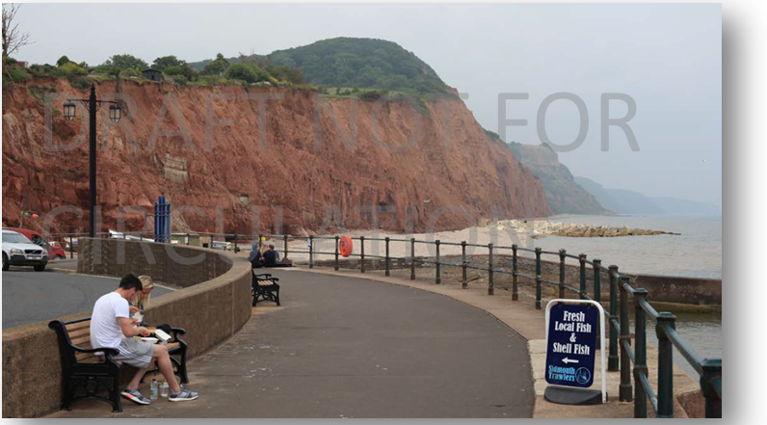
Preferred Option – East Beach
After
Before

Slide 23
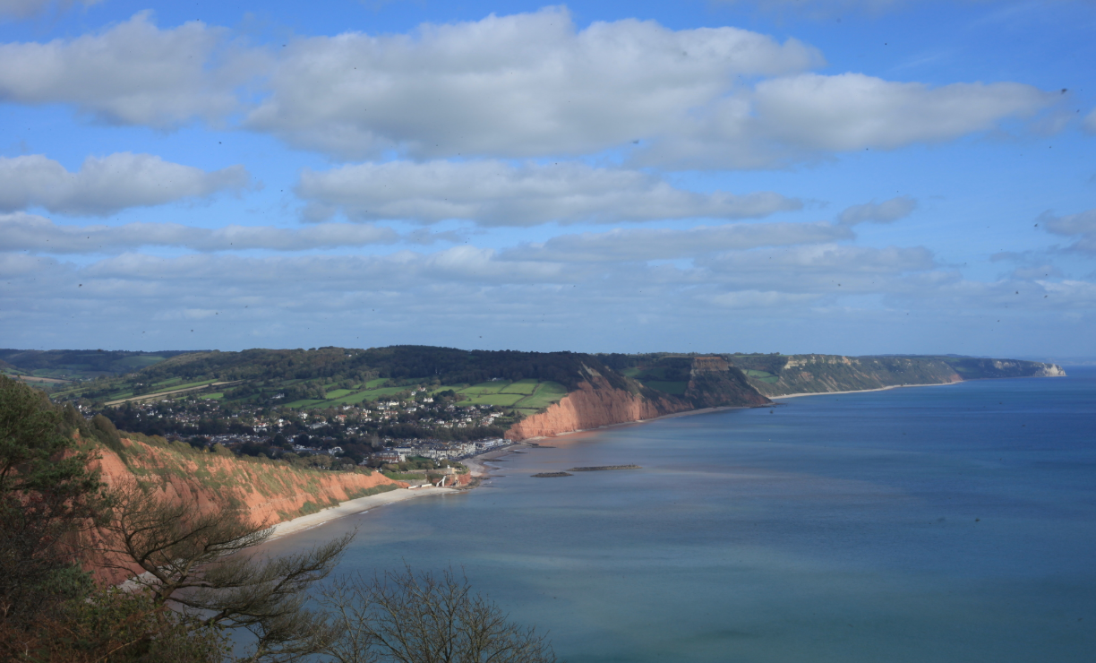
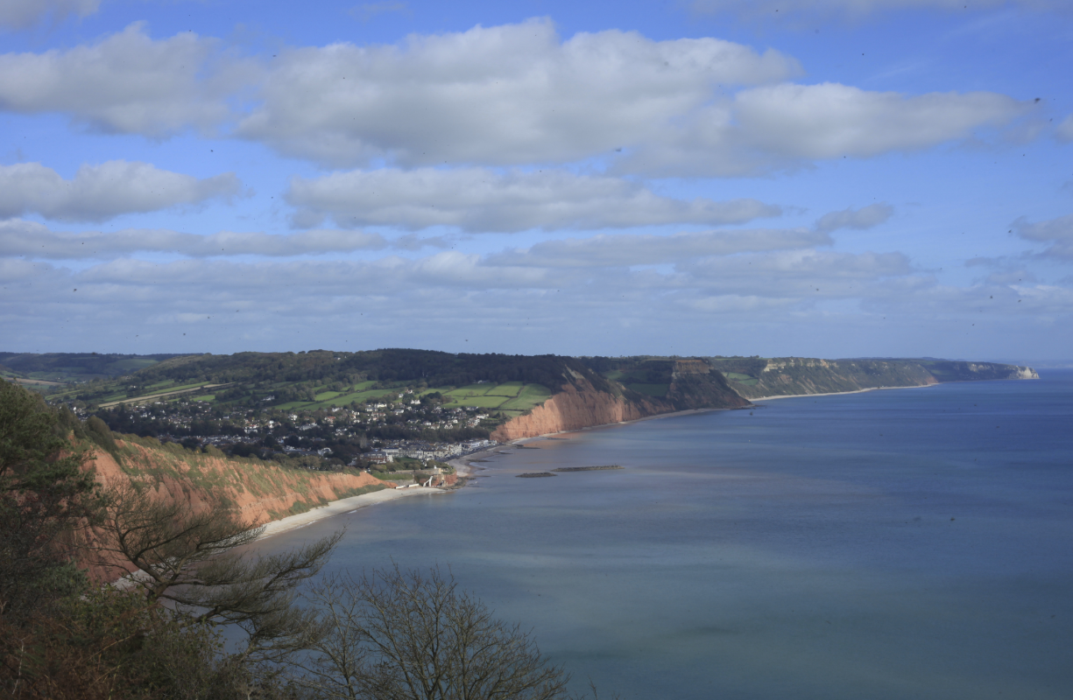
Preferred Option – East Beach
After
Before

Slide 24
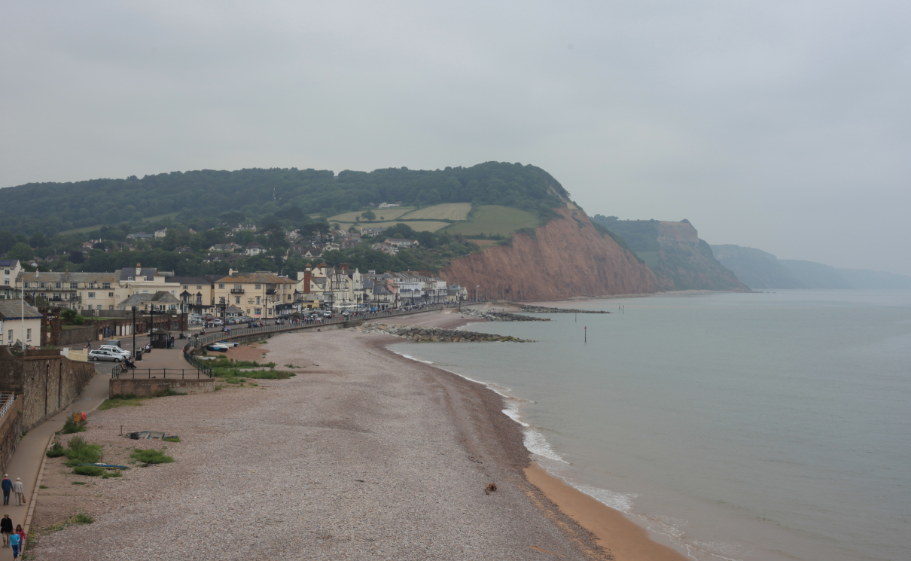
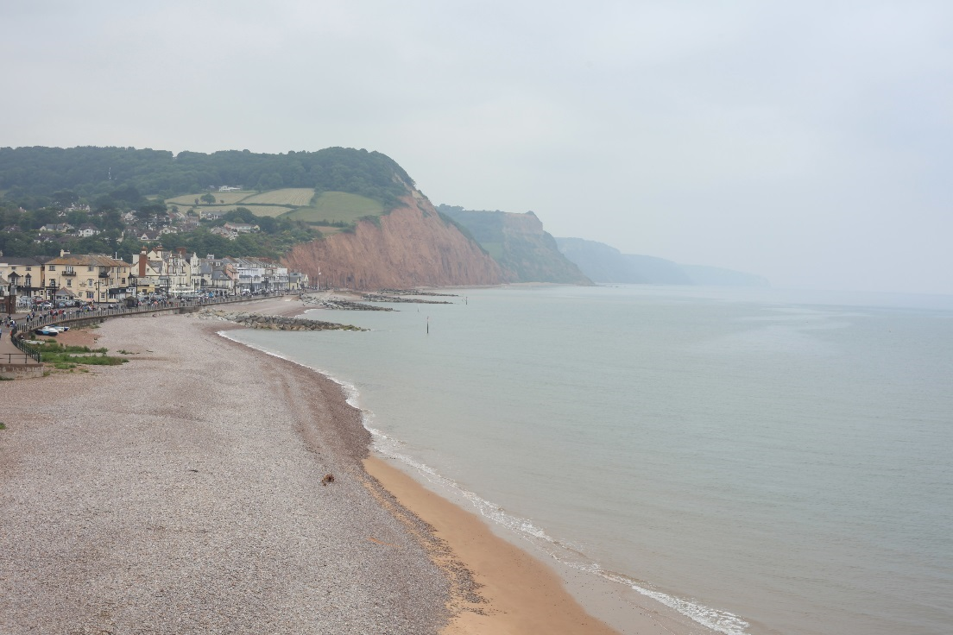
Preferred Option – Sidmouth Town
After
Before

Slide 25
Next Steps
2018
Undertake detailed review of financial risk within scheme costs
Review financial requirements with the Environment Agency
Secure Partnership Funding
2019
Formal submission of Outline Business Case
Detailed design
Preparation and submission of Planning Application and other licences and consent applications
2020
Construction phase

Slide 26
Partnership Funding
Likely partnership funding of around £3M required
Agreed £0.95M - £1.2M
EDDC £600k
DCC £250 - £500k
Sidmouth Town Council £100k
Potential contributions estimated £0.25M - £1.25M
South West Water
Local Levy
s106 sports
s106 tourism
EDDC Housing
Cliff Road Residents
Keith Owen Fund
Current gap £0.55M and 1.8M

